Slide 1

Introduction to ASP.NET MVC and Web API
Joe Wilson,
Volare Systems, Inc.
volaresystems.com/blog
@joe_in_denver

Slide 2
Agenda
Where do MVC and Web API fit in today’s web?
Basics of MVC
Basics of Web API
Are MVC or Web API a fit for your project?

Slide 3
Today’s web, same old HTTP
Request
GET, POST

 
Browser Client
Response
HTML, JSON, File, XML
Web
Server

Slide 4





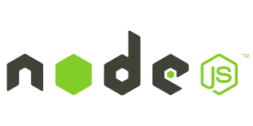




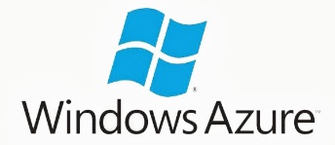

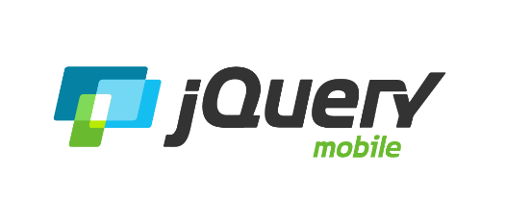

Today’s web, more abstractions, libraries, frameworks on top of HTTP
Request
GET, POST
Web Forms
MVC
Web API

 
Response
HTML, JSON, File, XML

Slide 5
Basics of MVC
M = Model
V = View
C = Controller
(R = Routing)

Slide 6
Basics of MVC - Routing
Controller
Action
http://server/product/edit

 
Request
Browser Client
Response
Web
Server
HTML, JSON, File, XML

Slide 7
Basics of MVC - Routing

Request (GET or POST)
Routing Engine
Controller (Action)
Response
View,
JSON, File,
XML
Model

Slide 8
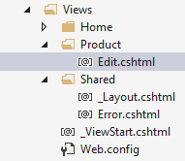
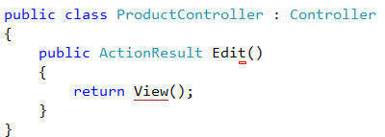
Basics of MVC - Routing
Controller
Action
http://server/product/edit
Folder
View

Slide 9
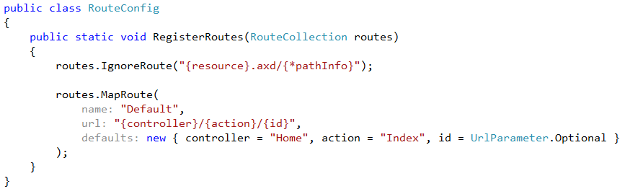
Basics of MVC – Routing (Default route)

Slide 10
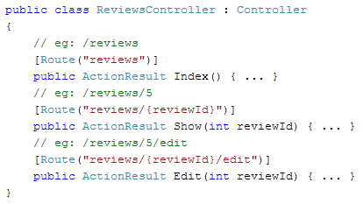
Basics of MVC – Routing (Route attributes)

Slide 11
Demo - Routing

Slide 12
Basics of MVC – Views
Are .CSHTML files
Hold user interface elements (HTML, CSS, JavaScript)
Use _Layout.cshtml to style pages the same for entire app
Views should not contain much logic
Simple “if”s or “foreach”es are OK

Slide 13
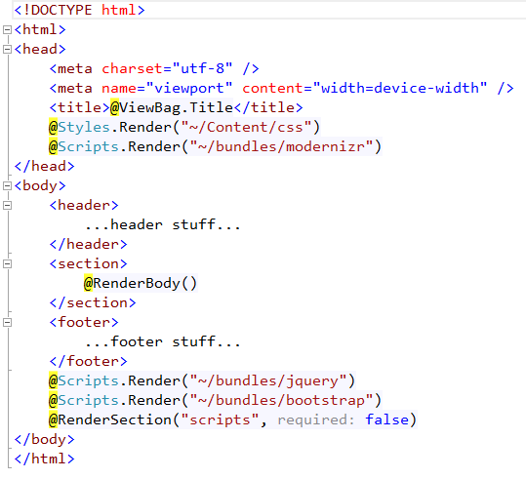
Basics of MVC – Views (_Layout.cshtml)

Slide 14
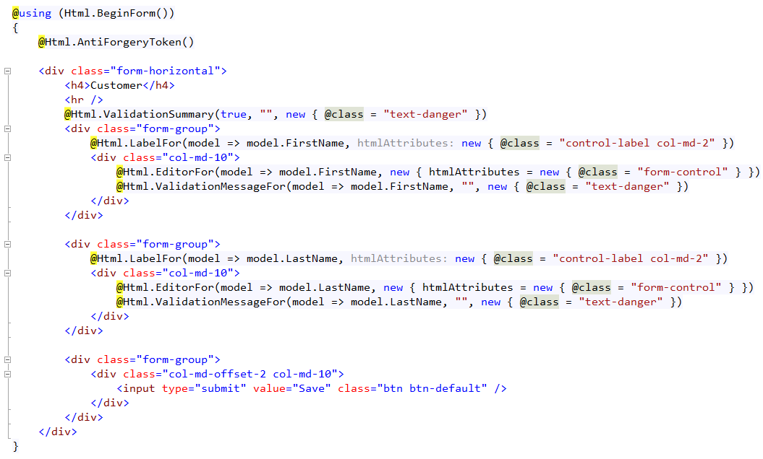
Basics of MVC – Views

Slide 15
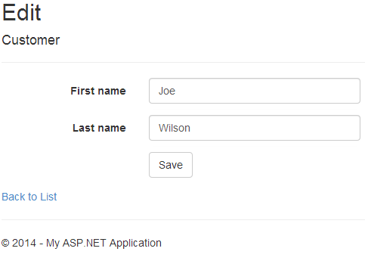
Basics of MVC – Views

Slide 16
Basics of MVC – Controllers
Are .CS files
Hold commands and workflows in Actions (methods)
Model bind values from form, query string, cookies, etc.
Works with Models for small logic and data
Validate user input before moving on
Render Views, JSON, XML, RSS, File, etc.

Slide 17
Basics of MVC – Models
Are .CS files or ViewBag, which is a dynamic type
Data to display in the View
Data posted from the View back to the Controller
Good place for validation attributes
Good place for light, display-related logic (Full Name, Totals, IsUserLoggedIn, etc.)

Slide 18
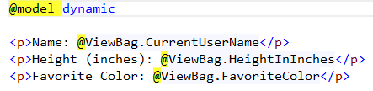

Basics of MVC – Models (ViewBag)
In Controller/Action..
In View….

Slide 19
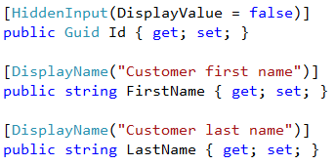
Basics of MVC – Validation

Slide 20
What problem is MVC trying to solve?
Problem: No Separation of Concerns guidance
Don’t just dump all your code in code behind files
MVC gives guidance about what kind of code goes where
Convention over configuration

Slide 21
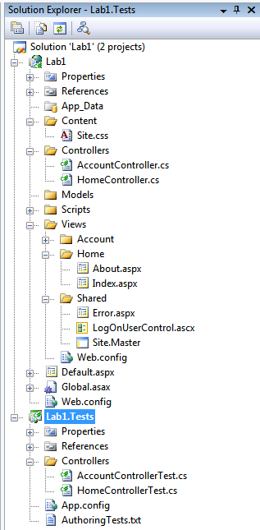
What problem is MVC trying to solve?
Style Sheets, Images
Controllers
Models
JavaScript
Views
Master Pages
Tests

Slide 22
What problem is MVC trying to solve?
Problem: Web code testability
Code behind files are hard to test
HttpContext is hard to mock
MVC provides mockable abstract classes (but mocking is still not as easy as it could be)

Slide 23
What are the benefits of MVC?
Benefit: Clean HTML
MVC controls keep their IDs
Easier to navigate with JavaScript and jQuery
Easier to build Section 508 compliant sites

Slide 24
What are the benefits of MVC?
HTML from Web Forms
<span id="ctl00_MainContent_uxdPHAllContent_TripSelector_lblFromDate">
From Date:</span>
<input type="text" name="ctl00$MainContent$uxdPHAllContent$TripSelector$txtFromDate" id="ctl00_MainContent_uxdPHAllContent_TripSelector_txtFromDate" />
HTML from MVC
<label for="FromDate">From Date:</label>
<input type="text" name="FromDate" id="FromDate" />

Slide 25
What are the benefits of MVC and Web API?
Benefit: Clean URLs
MVC and Web API have more hackable, SEO-friendly URLs
URLs with or without query strings

Slide 26
What are the benefits of MVC?
URLs with query strings
http://mysite.com/Shop.aspx?Category=Shirts
http://mysite.com/Shop.aspx?ID=123
URLs in MVC and Web API
http://mysite.com/Shop/Category/Shirts
http://mysite.com/Shop/ID/123

Slide 27
What are the benefits of MVC and Web API?
Benefit: Headroom
Extensible
Custom Routing
Custom View Engine
Custom Model/Parameter Binders
Custom Action Filters
Custom Formatters
All code is released as open source

Slide 28
Code!

Slide 29
What are the benefits of MVC and Web API?
Part of ASP.NET, same security model
Can run side-by-side with Web Forms, SignalR, etc.
Cookies, Session, Caching, etc. still work the same
Extensible for changing Routing, View Engine, Model Binders, Action Filters, etc.

Slide 30
Today’s web, where do MVC and Web API fit?
MVC
ASP.NET security for pages
Model binding, server-side validation
Easy to send data from the server with the view
Consistent look with a Layout page
Web API
ASP.NET security for data calls
Parameter binding, server-side validation
Content negotiation to send JSON, XML, etc.
Easy way to get JSON to the client
Clean, predictable REST api for people outside your dev team

Slide 31
Resources
Microsoft site for MVC - asp.net/mvc
Microsoft site for Web API - asp.net/web-api
Pluralsight - pluralsight.com
volaresystems.com/blog
@joe_in_denver

